Slide 1
Chapter 23 Transition Metals and Coordination Chemistry

Slide 2
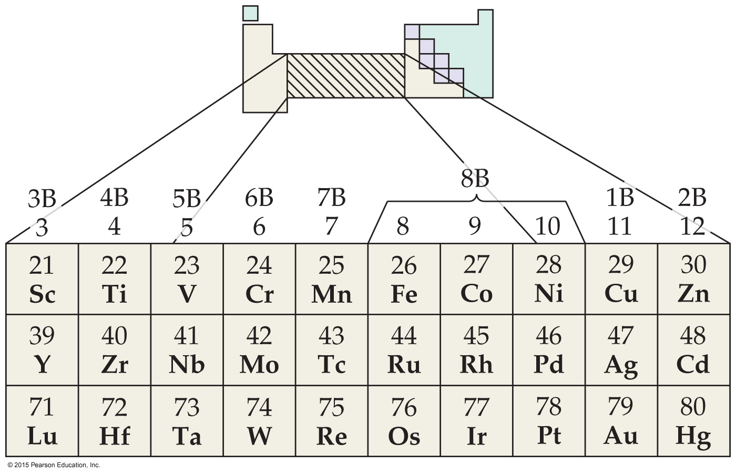

Why are Transition Metals of Interest?
Color
Catalysts
Magnets
Biological roles
Coordination compounds (metals bonded to molecules and ions)
Transition
Metals

Slide 3
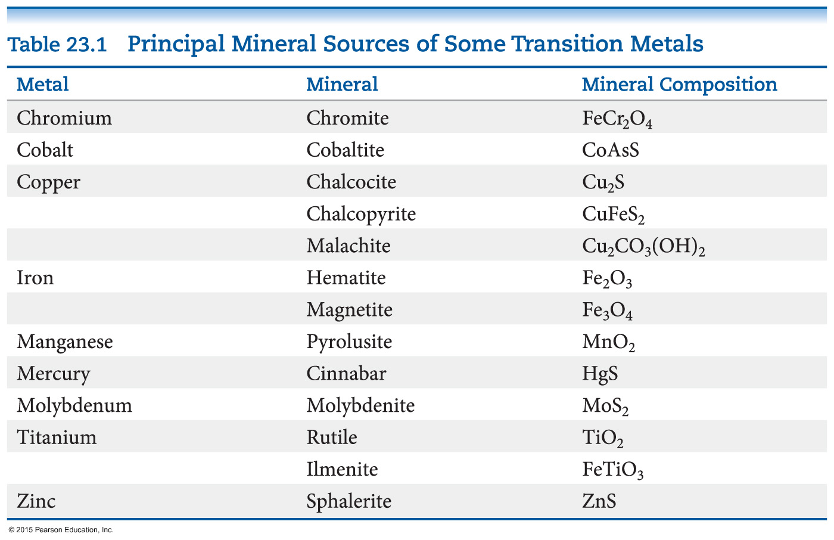
Minerals 矿物
Most metals, including transition metals, are found in solid inorganic compounds known as minerals.
Minerals are named by common, not chemical, names.
Most transition metals range from +1 to +4 oxidation state in minerals.
Transition
Metals

Slide 4
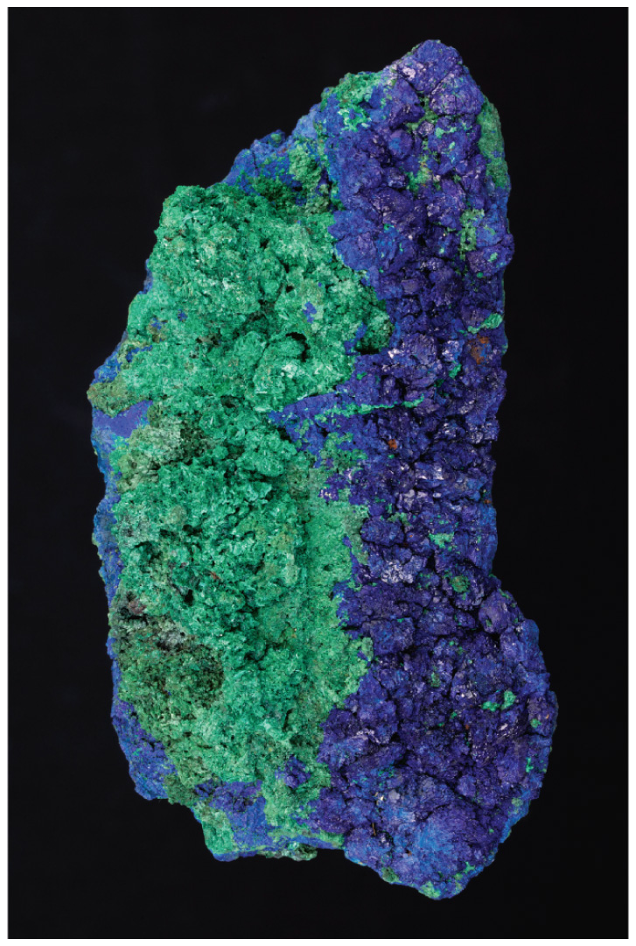
Metallurgy 冶金学
The science and technology of extracting metals from their natural sources and preparing them for practical use.
Steps often involved:
Mining
Concentrating the ore
Reducing the ore to free metal
Purifying the metal
Mixing it with other elements to modify its properties (making an alloy—a solid mixture)
Transition
Metals

Slide 5
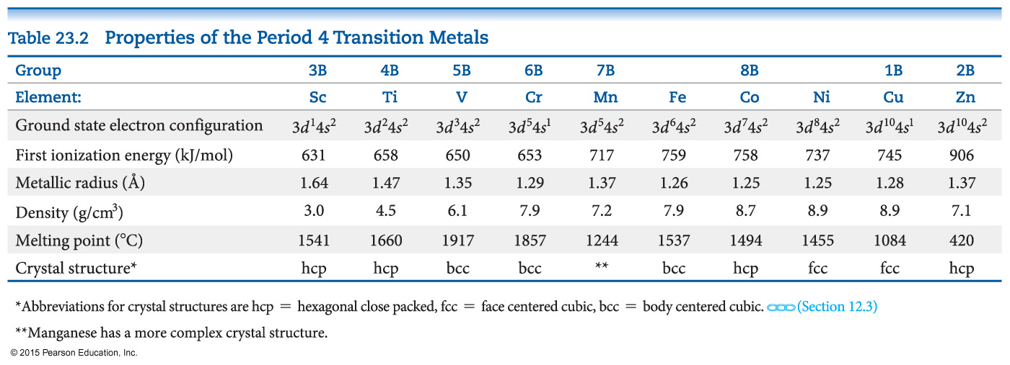
Properties of the First Row Transition Metals
“First row” means period 4.
Periods 5 and 6 have similar trends in properties.
Transition
Metals

Slide 6
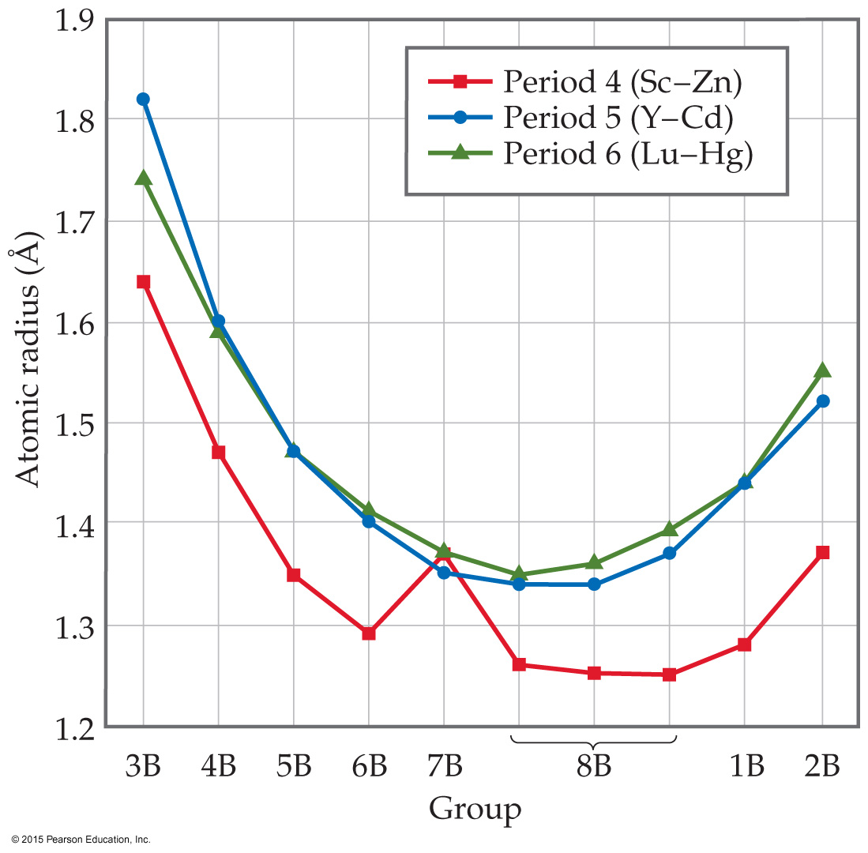
Atomic Radius
As one goes from left to right, a decrease, then an increase, is seen in the radius of transition metals.
On the one hand, increasing effective nuclear charge tends to make atoms smaller.
On the other hand, the strongest (and, therefore, shortest) metallic bonds are found in the center of the transition metals.
Periods 5 and 6 are about the same size due to the lanthanide contraction—the effect of 4f electrons on effective nuclear charge.
Transition
Metals

Slide 7
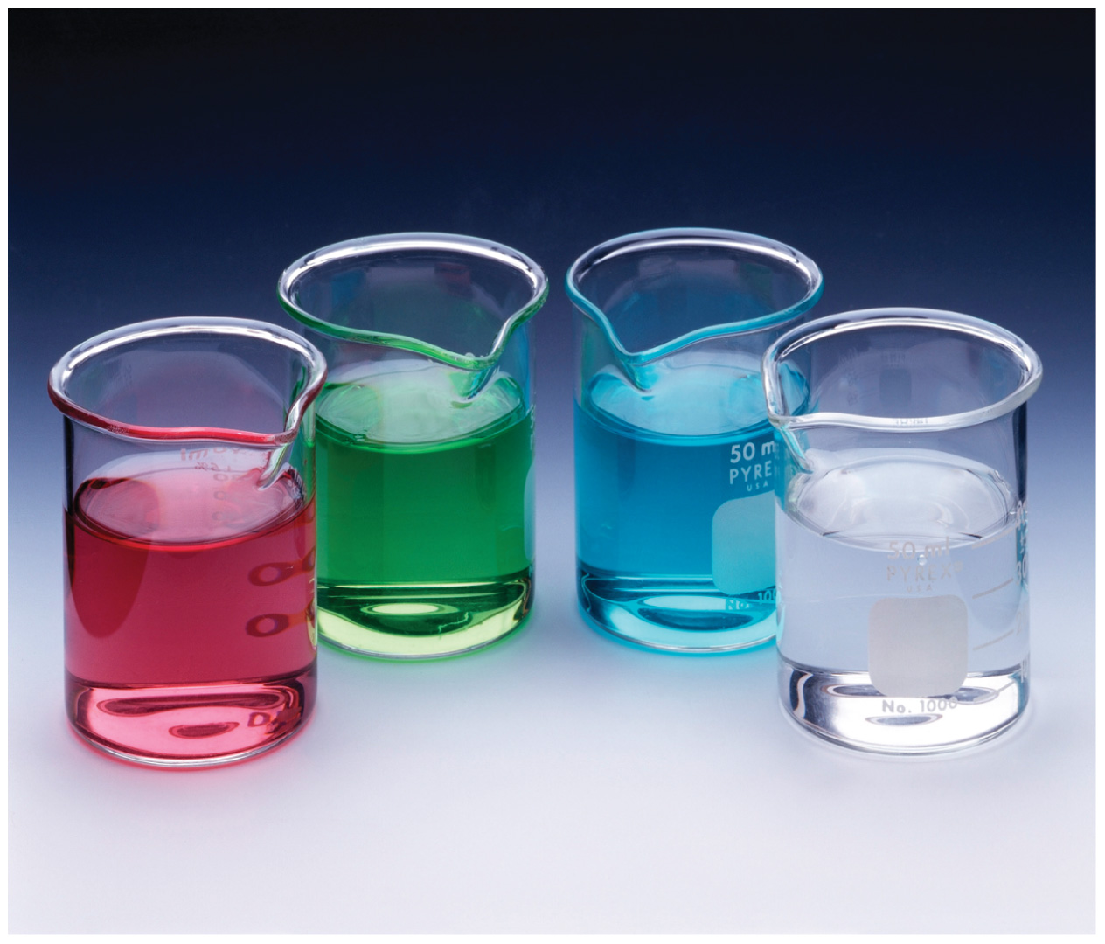
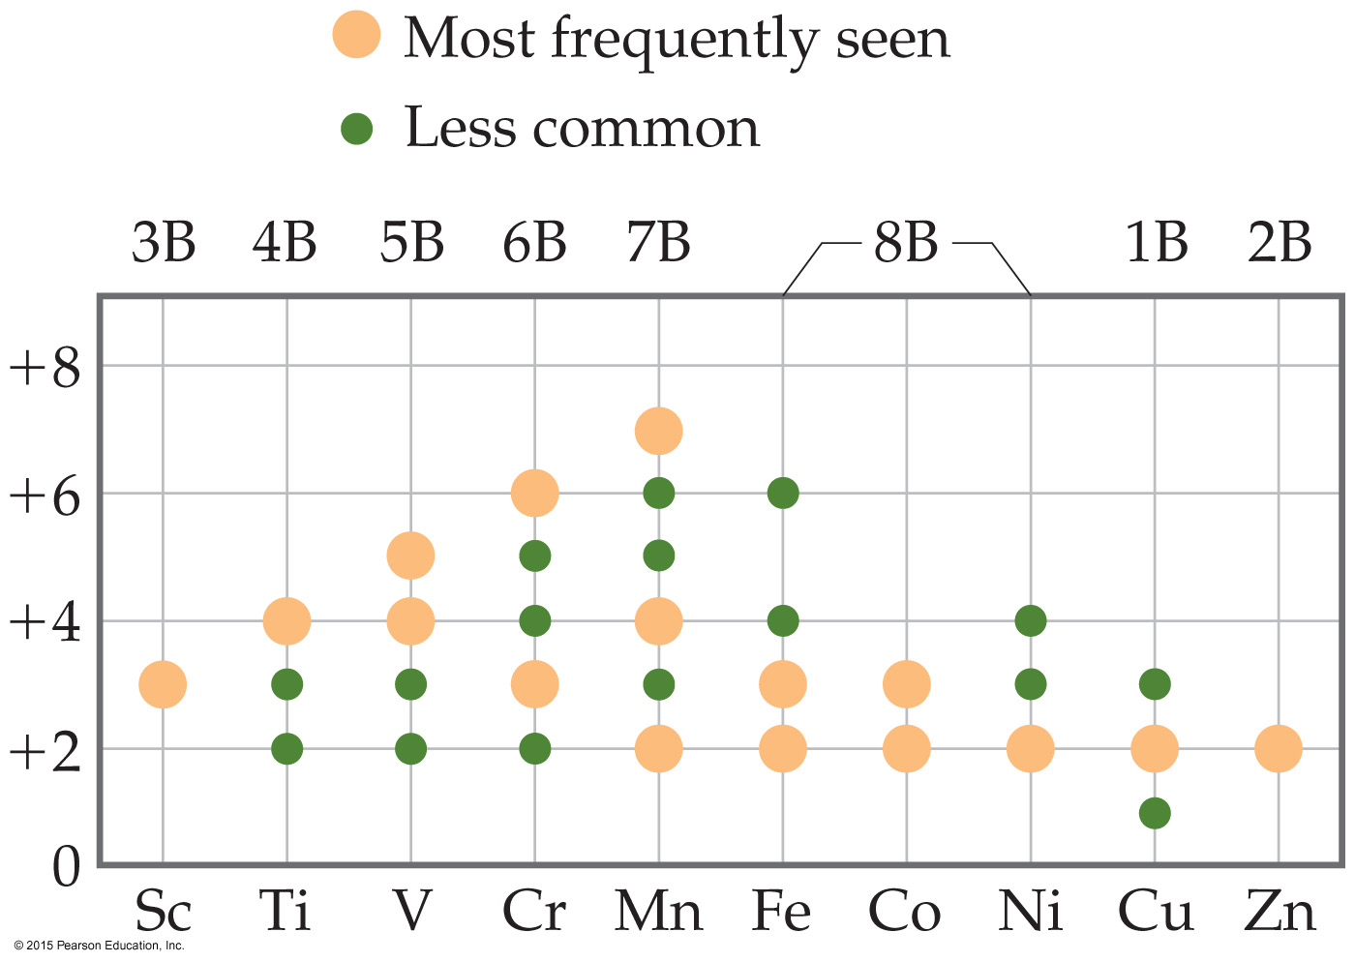
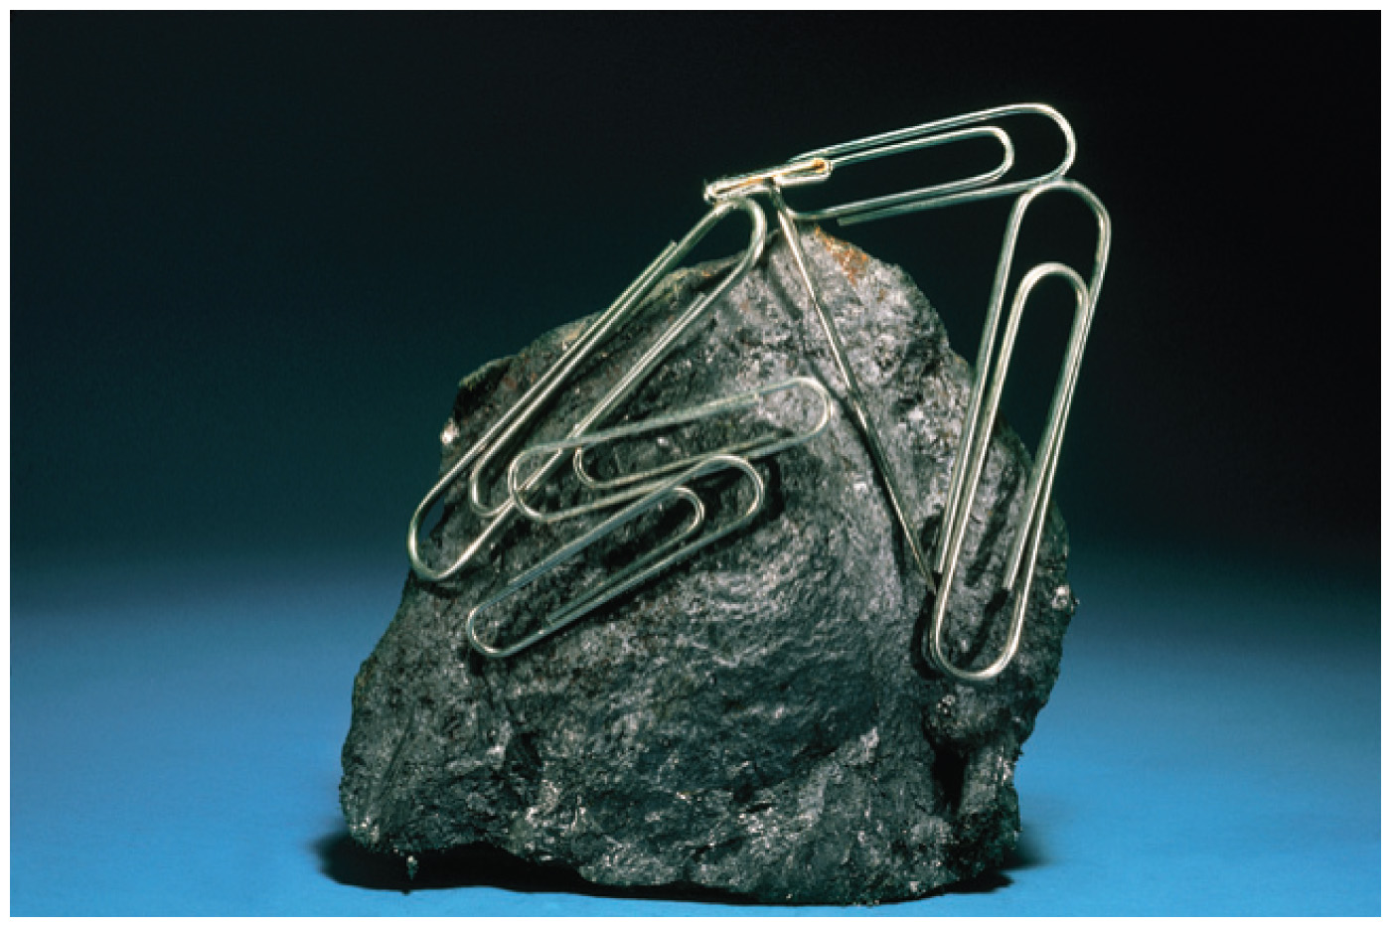
Transition Metal Characteristics
Partially occupied d sublevels lead to the possibility of
multiple oxidation states;
colored compounds;
magnetic properties.
Transition
Metals

Slide 8
Oxidation States
For the period 4 transition elements,
when cations are formed, they lose the 4s electrons first; all (except Sc) form a +2 cation (have a +2 oxidation state).
from Sc to Mn (4s²3d⁵), the maximum oxidation state is the sum of 4s and 3d electrons.
after Mn, the maximum oxidation number decreases, until Zn, which is ONLY +2.
Transition
Metals

Slide 9
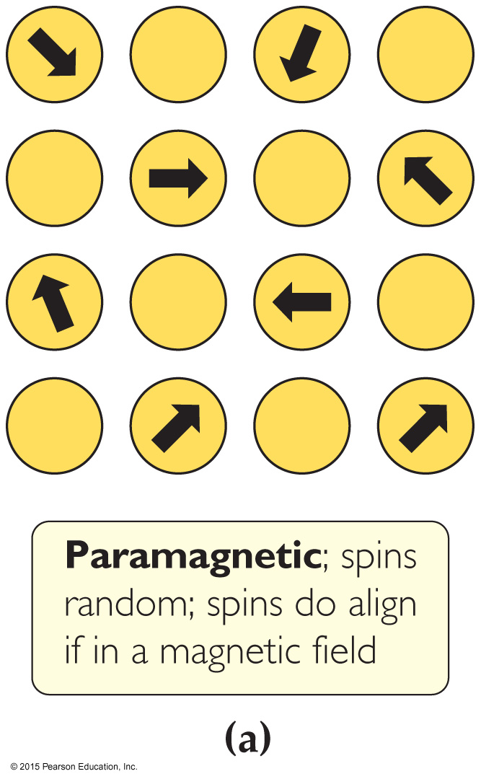
Magnetism
Electrons possess spin, causing a magnetic moment.
When all electrons are spin-paired, the moments cancel each other out: this is a diamagnetic (反磁性) solid.
With unpaired electron(s), the substance is called paramagnetic (顺磁性). In these substances, the adjacent atoms don’t affect each other.
In three other types of magnetism, the atoms affect each other: ferromagnetic （铁磁）, antiferromagnetic （反铁磁）, and ferrimagnetic （亚铁磁）. (These become paramagnetic at higher temperatures.)
Transition
Metals

Slide 10
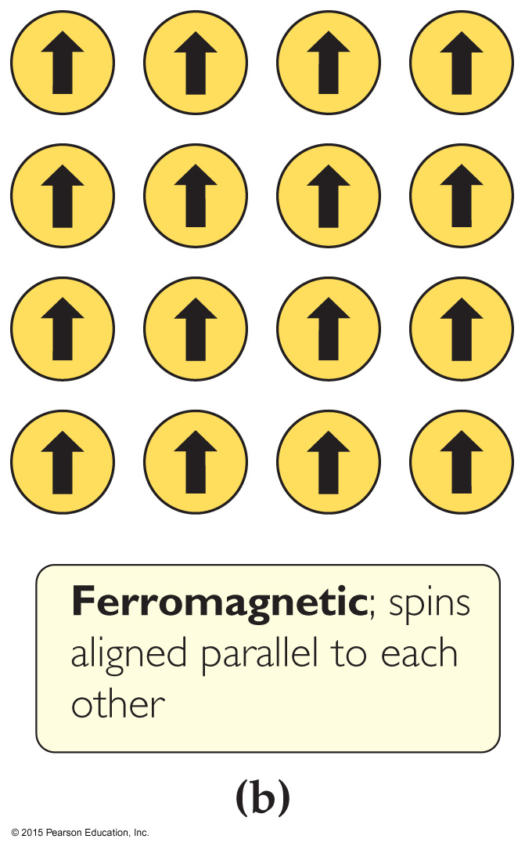
Ferromagnetism 铁磁性
In ferromagnetic substances, the unpaired spins influence each other to align in the same direction, thereby exhibiting strong attractions to an external magnetic field.
Such species are permanent magnets. （永久磁铁）
Elements: Fe, Co, Ni; also many alloys
Transition
Metals

Slide 11
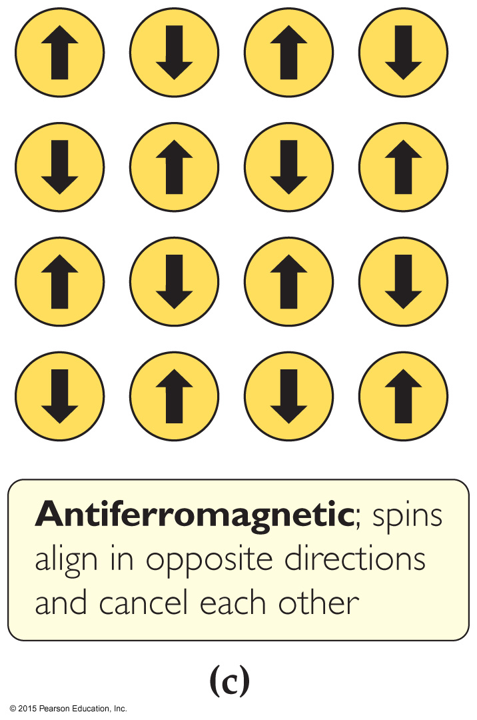
Antiferromagnetism 反铁磁性
Antiferromagnetic substances have unpaired spins on adjacent atoms that align in opposing directions.
These magnetic fields tend to cancel each other.
Examples—element: Cr; alloys: FeMn; transition metal oxides: Fe₂O₃, LaFeO₃, MnO
Transition
Metals

Slide 12
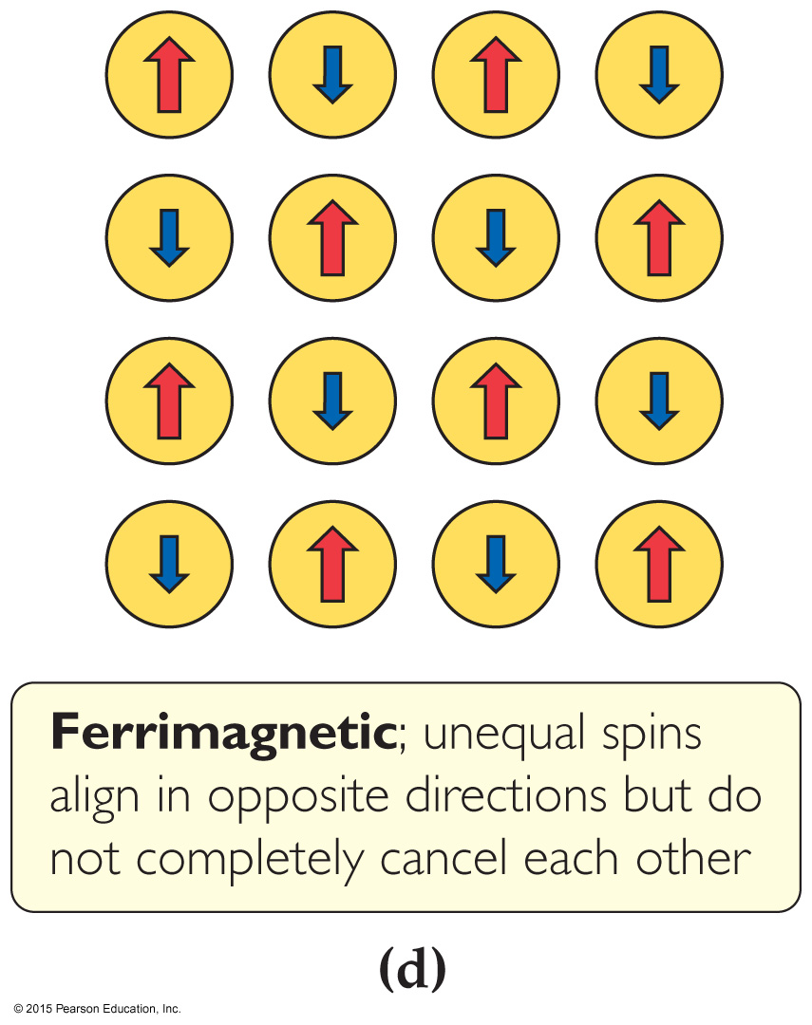
Ferrimagnetism 亚铁磁性
Ferrimagnetic substances have spins that align opposite each other, but the spins are not equal, so there is a net magnetic field.
This can occur because
magnetic centers have different numbers of unpaired electrons;
more sites align in one direction than the other;
both of these conditions apply.
Examples are NiMnO₃, Y₃Fe₅O₁₂, and Fe₃O₄.
Transition
Metals

Slide 13
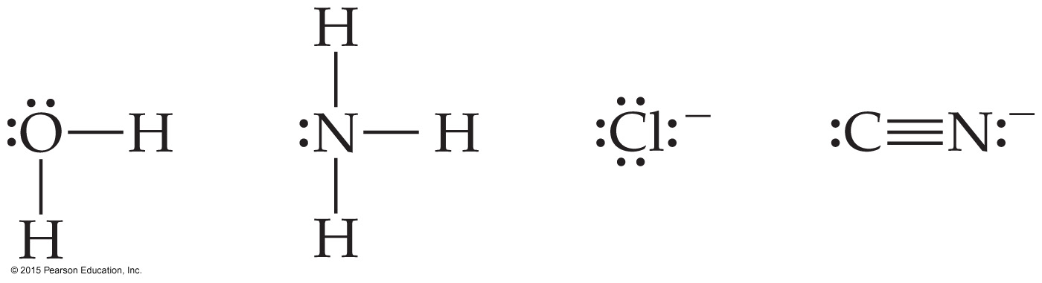
Complexes 络合物
Commonly, transition metals can have molecules or ions that bond to them, called ligands. 配体
These give rise to complex ions 络合离子 or coordination compounds 配位化合物.
Ligands act as Lewis bases, donating a pair of electrons to form the ligand–metal bond.
Four of the most common ligands:
Transition
Metals

Slide 14
Alfred Werner’s Theory on Transition Metal Complexes
Many compounds exist combining CoCl₃ and NH₃. Their nature was explained by Alfred Werner in 1893.
The oxidation number of a metal is +3 in each compound. However, the number of atoms bonded to the metal is different. He called this the coordination number 配位数.
Transition
Metals

Slide 15
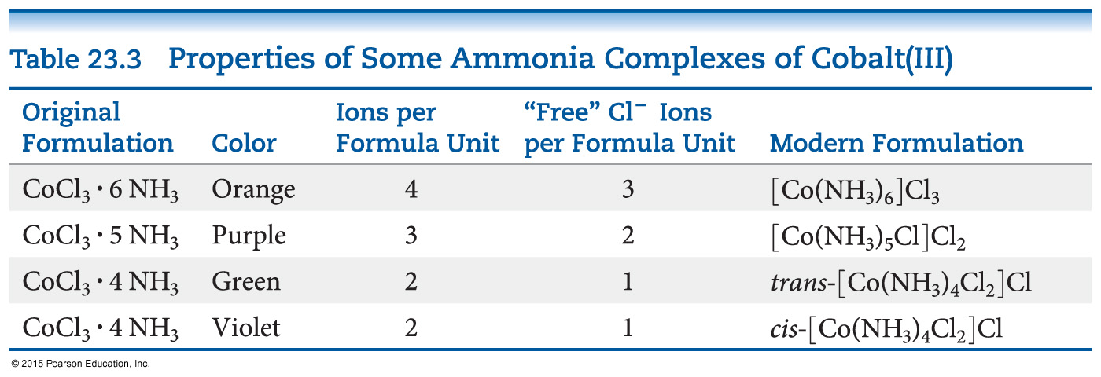
Werner’s Theory
The key to solving this problem is the number of ions produced in solution per formula unit: along with ONE cation, the rest would tell how many Cl– ions are NOT connected directly to the metal.
Precipitation of AgCl confirmed amount of free Cl–.
Writing the formula: the square brackets show the complex; counterions are written after.
Transition
Metals

Slide 16
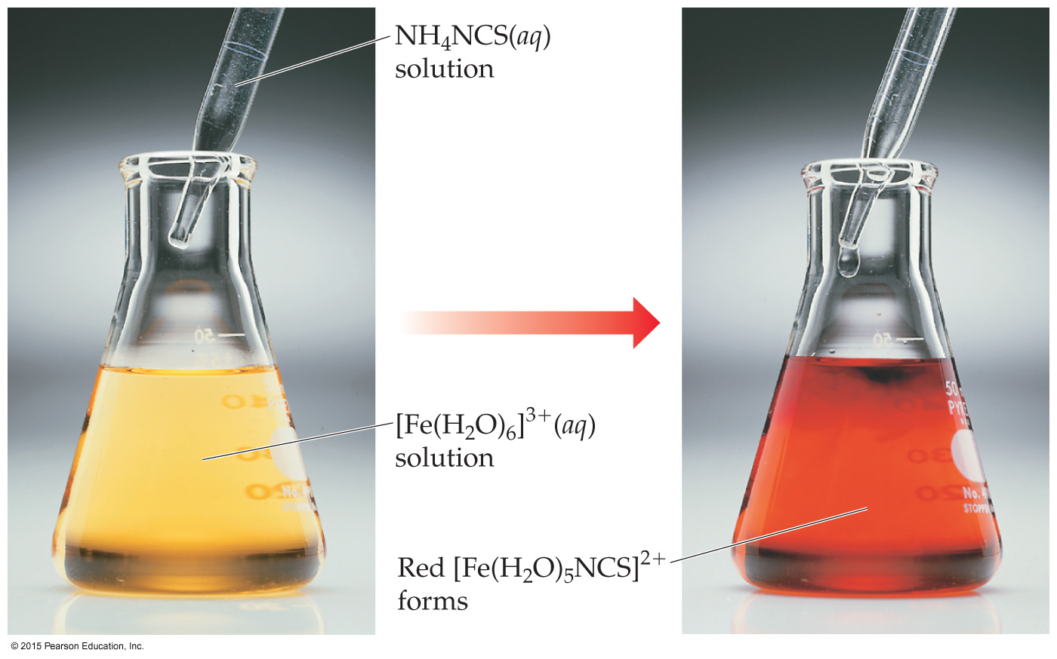
The Metal–Ligand Bond
The reaction between a metal and a ligand is a reaction between a Lewis acid (the metal) and a Lewis base (the ligand).
The new complex has distinct physical and chemical properties (e.g., color, reduction potential).
Transition
Metals

Slide 17
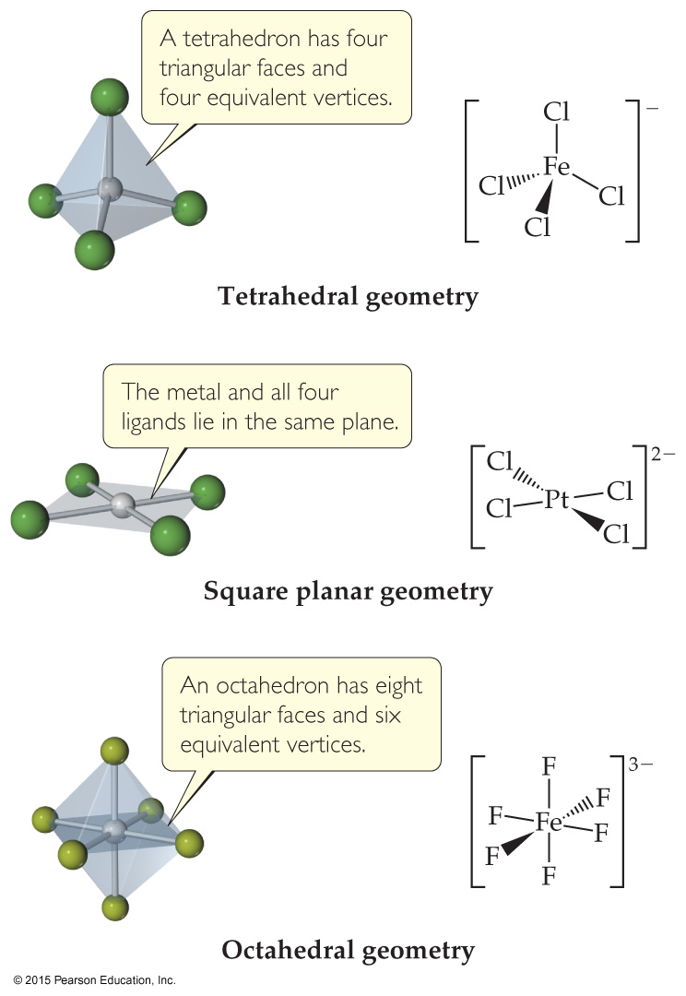
Coordination Numbers 配位数
The coordination number of a metal depends upon the size of the metal and the size of the ligands.
Iron(III) can bind to 6 fluorides but only 4 chlorides (larger).
The most common coordination numbers are 4 and 6. They correspond to common geometries: tetrahedral or square planar; octahedral.
Transition
Metals

Slide 18
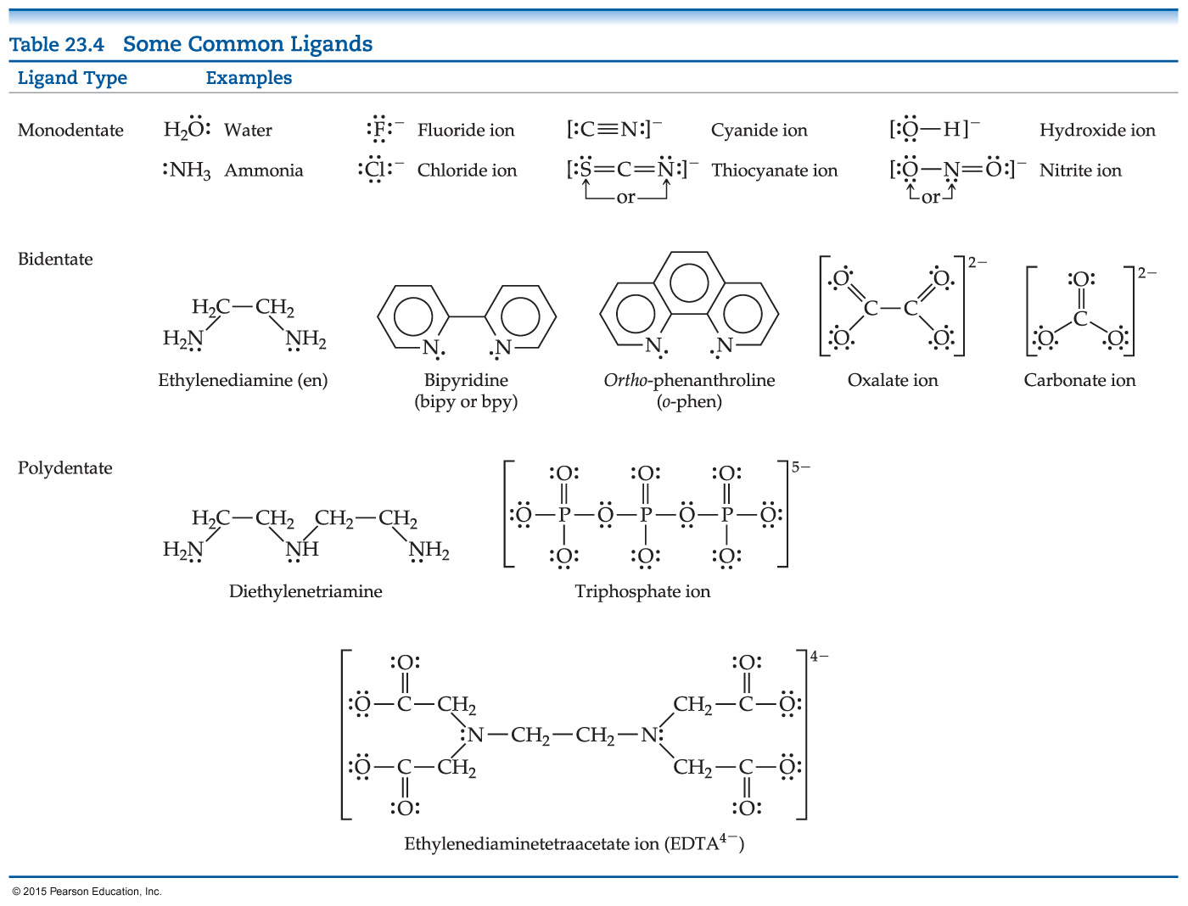
Common Ligands
The table shown contains some ligands commonly found in complexes. Monodentate 单配位基 ligands coordinate to one site on the metal, bidentate 双配位基 to two sites.
Transition
Metals

Slide 19
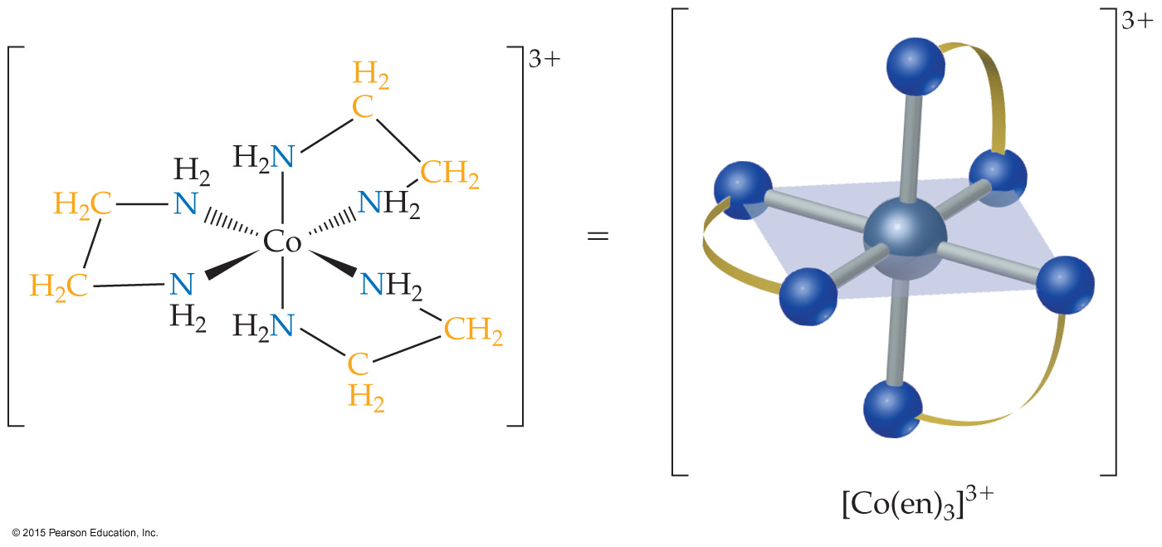
Chelates 螯合物
Bidentate and polydentate ligands are also called chelating agents. 螯合剂
There are many transition metals that are vital to human life，several of these are bound to chelating agents.
Transition
Metals

Slide 20
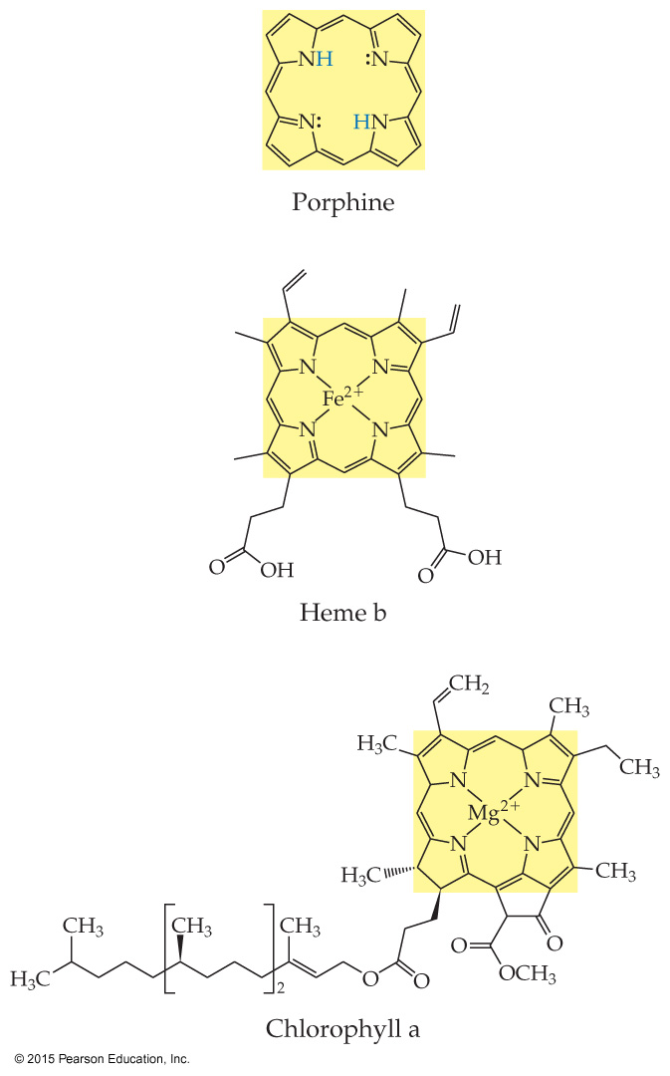
Chelates in Biological Systems
The porphine 卟啉 molecule is the basis for many important biological metal chelates, becoming a porphyrin ring.
The iron in hemoglobin 血红蛋白 carries O₂ and CO₂ through the blood. It contains heme units. 亚铁血红素
Chlorophylls 叶绿素 also have metals bound to porphine units.
Transition
Metals

Slide 21
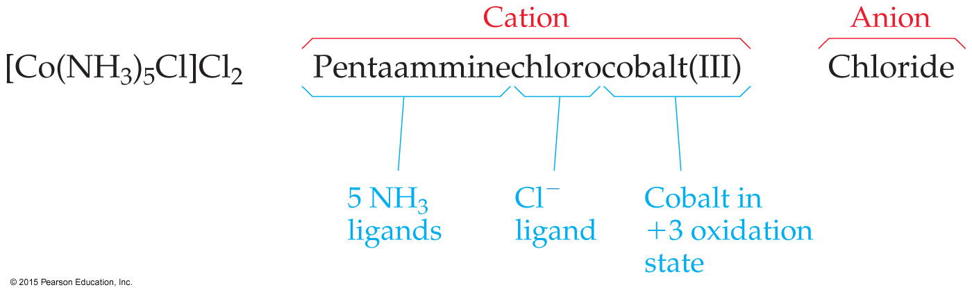
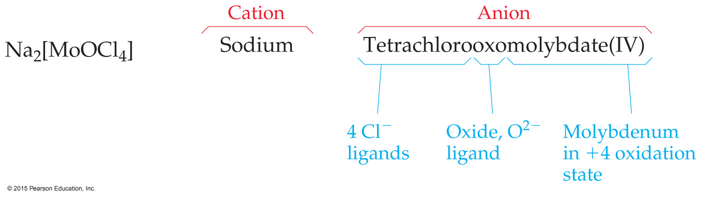
Nomenclature Rules 命名法 for Coordination Chemistry
In naming complexes that are salts, the name of the cation is given before the name of the anion.
In naming complex ions or molecules, the ligands are named before the metal. Ligands are listed in alphabetical order, regardless of their charges.
Transition
Metals

Slide 22
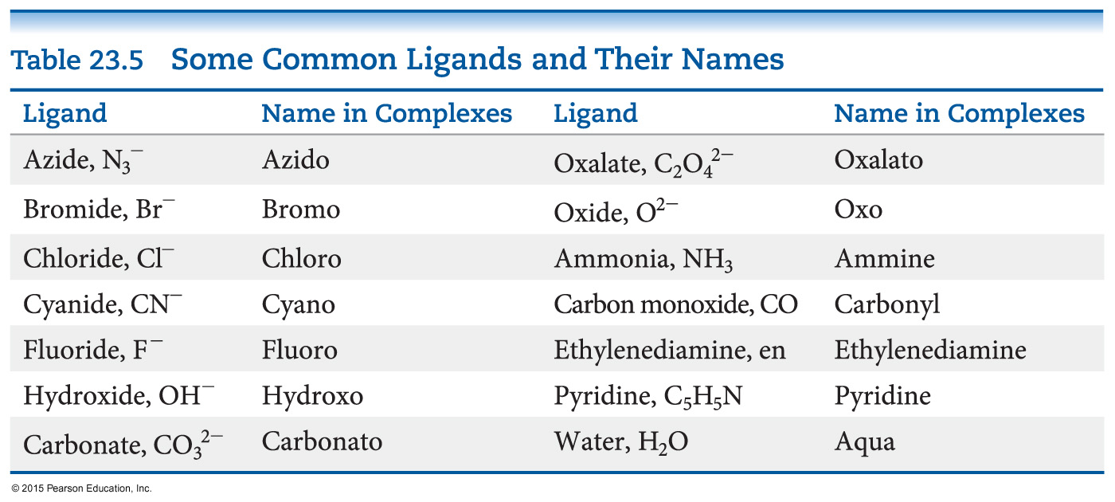
Nomenclature Rules
The names of anionic ligands end in the letter o, but electrically neutral ligands ordinarily bear the name of the molecules (exceptions: ammonia, water, CO).
Transition
Metals

Slide 23
Nomenclature Rules
Greek prefixes (di-, tri-, tetra-, etc.) are used to indicate the number of each kind of ligand when more than one is present. If the ligand contains a Greek prefix or is polydentate, the prefixes bis-, tris-, tetrakis-, etc. are used and the ligand name is placed in parentheses 括号.
If the complex is an anion, its name ends in -ate.
The oxidation number of the metal is given in parentheses in Roman numerals following the name of the metal.
Transition
Metals

Slide 24
Nomenclature Examples
[Ni(NH₃)₆]Br₂ =
Hexaamminenickel(II) bromide
Na₂[MoOCl₄] =
Sodium tetrachlorooxomolybdate(IV)
[Co(en)₂(H₂O)(CN)]Cl₂ =
Aquacyanobis(ethylenediamine)cobalt(III) chloride
Transition
Metals

Slide 25
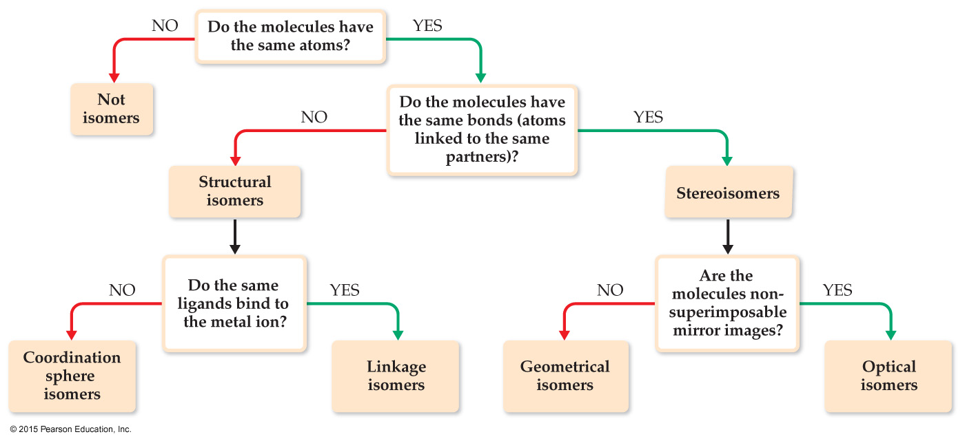
Isomers 同分异构体
Isomers have the same molecular formula but a different arrangement of atoms.
There are two main subgroupings: structural isomers 结构异构体 (same molecular formula but different connections of atoms) and stereoisomers 立体异构体 (same connections of atoms, but different three-dimensional orientations).
Transition
Metals

Slide 26
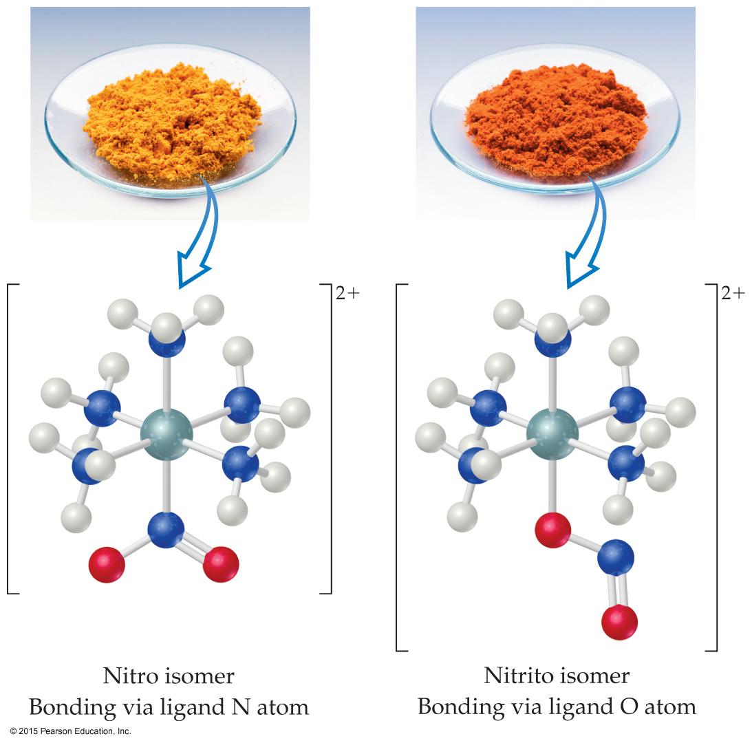
Linkage Isomers 键合异构体
In linkage isomers the ligand is bound to the metal by a different atom. For example, nitrite can bind via the N or via an O.
Transition
Metals

Slide 27
Coordination Sphere Isomers 配位层异构体
Coordination sphere isomers differ in what ligands are bound to the metal and which fall outside the coordination sphere.
For example, CrCl₃(H₂O)₆ exists as [Cr(H₂O)₆]Cl₃, [Cr(H₂O)₅Cl]Cl₂ • H₂O, or [Cr(H₂O)₄Cl₂]Cl • 2H₂O.
Transition
Metals

Slide 28
Stereoisomers 立体异构体
Same chemical bonds but different spatial arrangements.
Two types:
Geometric isomers 几何异构体
Optical isomers 旋光异构体

Slide 29
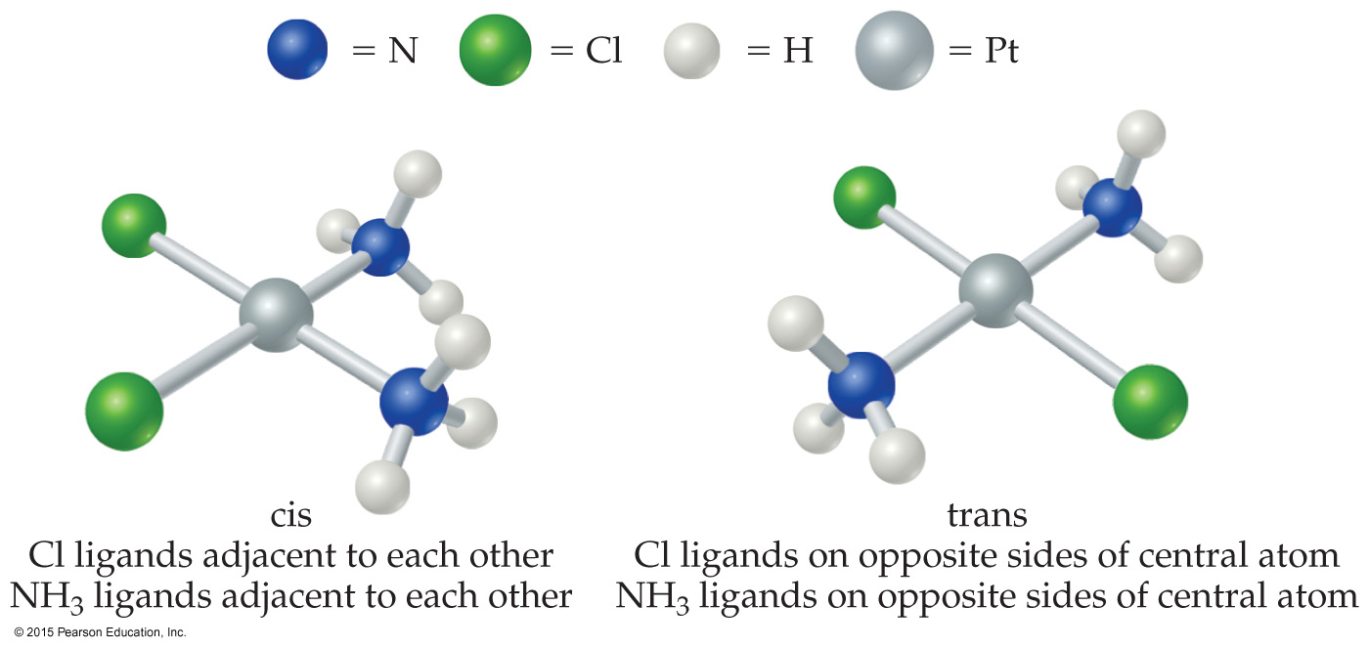
Geometric Isomers 几何异构体
In geometric isomers, the arrangement of the atoms is different, but the same bonds exist on the complex.
For example, chlorine atoms can be adjacent to each other (cis ) 顺式 or opposite each other (trans) 反式; found in square planar or octahedral complexes, not tetrahedral.
They have different physical properties and, often, different chemical reactivity!
Transition
Metals

Slide 30
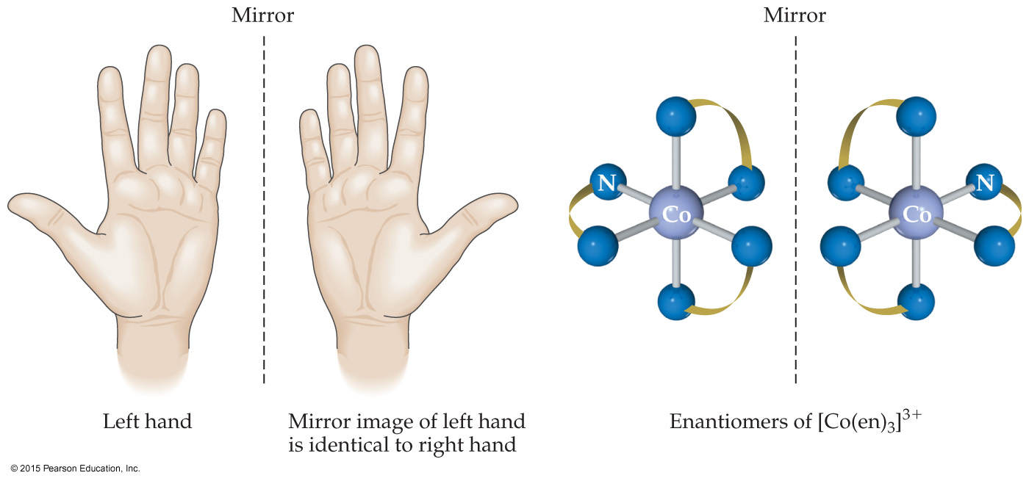
Optical Isomers 旋光异构体
Optical isomers, or enantiomers 对映异构体, are mirror images of one another that don’t superimpose on each other.
They are said to be chiral 手性.
Their properties differ from each other only when in contact with other chiral substances.
Transition
Metals

Slide 31
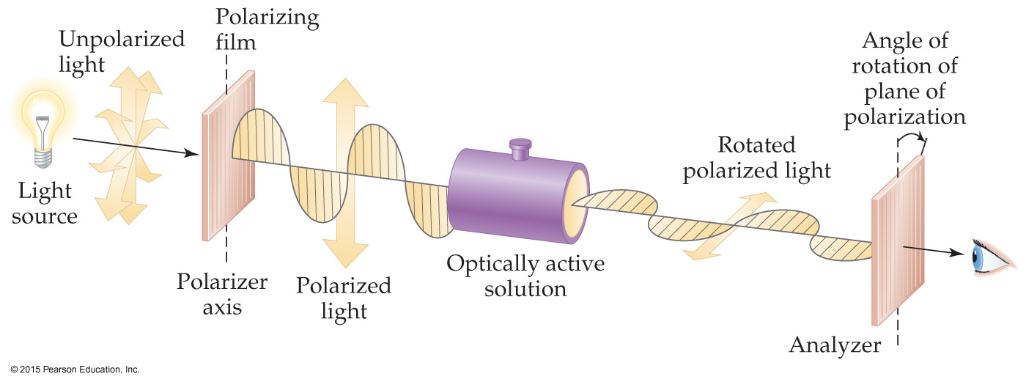
Optical Isomers
Enantiomers are distinguished from each other by the way they rotate plane-polarized light.
Substances that rotate plane-polarized light to the right are dextrorotatory. 右旋
Substances that rotate plane-polarized light to the left are levorotatory. 左旋
A mixture of the two is called a racemic mixture. 外消旋混合物
Transition
Metals

Slide 32
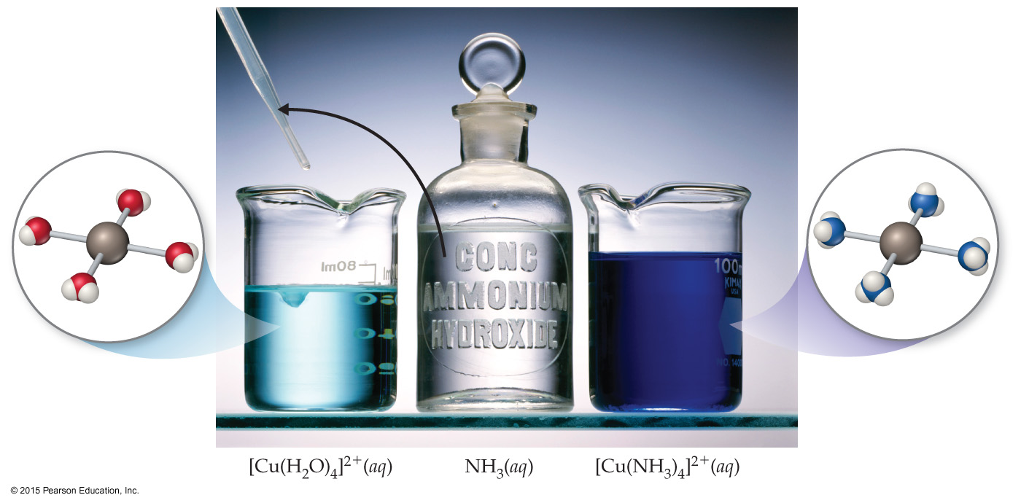
Color
Color depends on the metal AND the ligands.
Transition
Metals

Slide 33
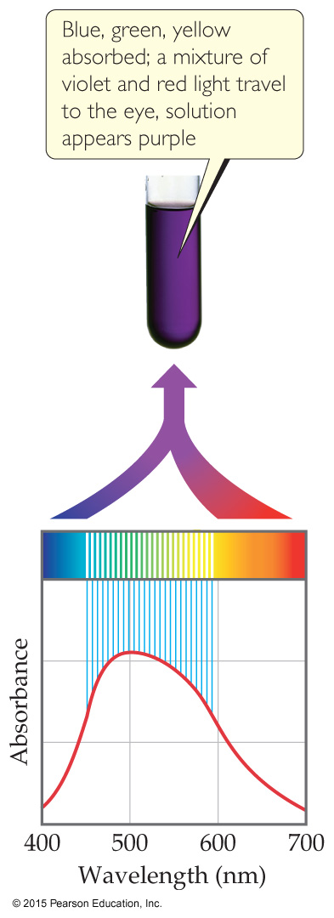
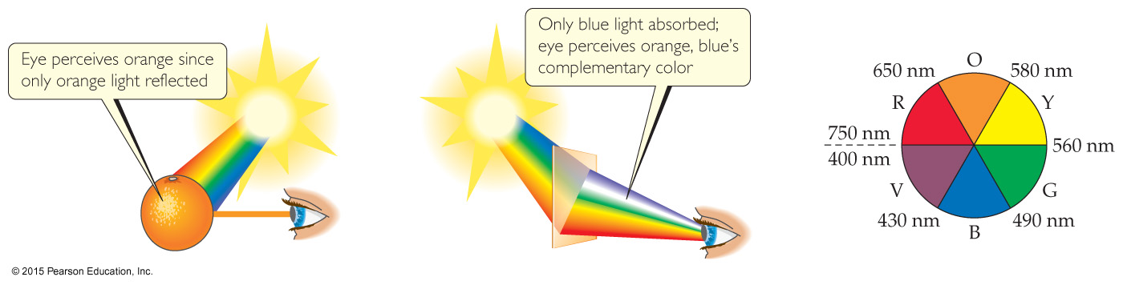
Color
Two ways we see color in a complex:
Object reflects that color of light.
Object transmits all colors EXCEPT the complementary color 互补色 (as is seen in an absorption spectrum).
Transition
Metals

Slide 34
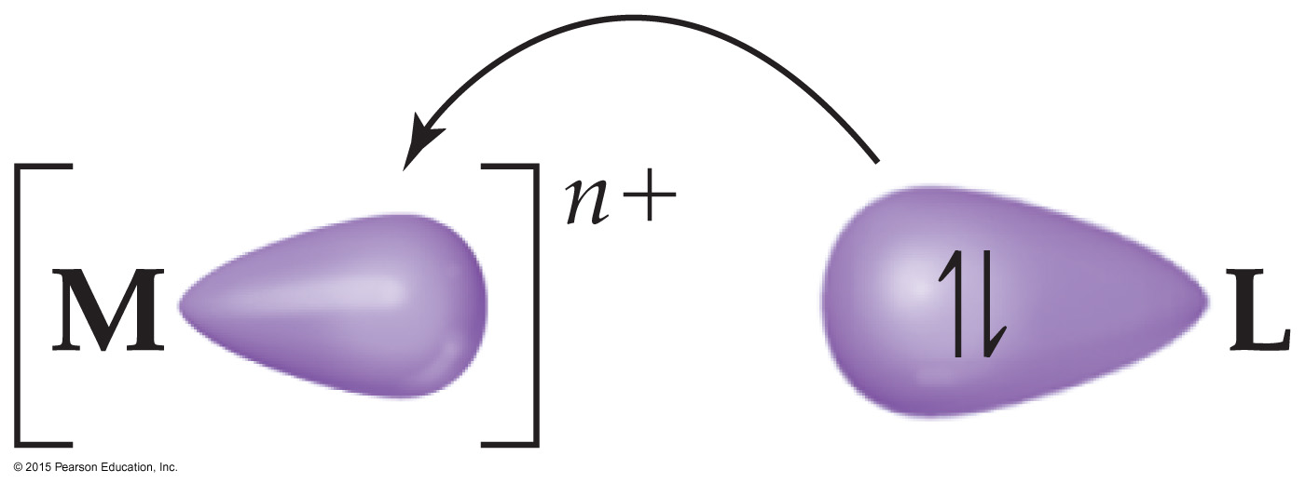
Crystal-Field Theory 晶体场理论
As was mentioned earlier, ligands are Lewis bases that are attracted to a Lewis acid (the metal).
But d electrons on the metal would repel the ligand.
In crystal-field theory, the approaching ligand is considered to be a negative point of charge repelled by the electrons in a metal’s d-orbitals. (see next page)
Transition
Metals

Slide 35
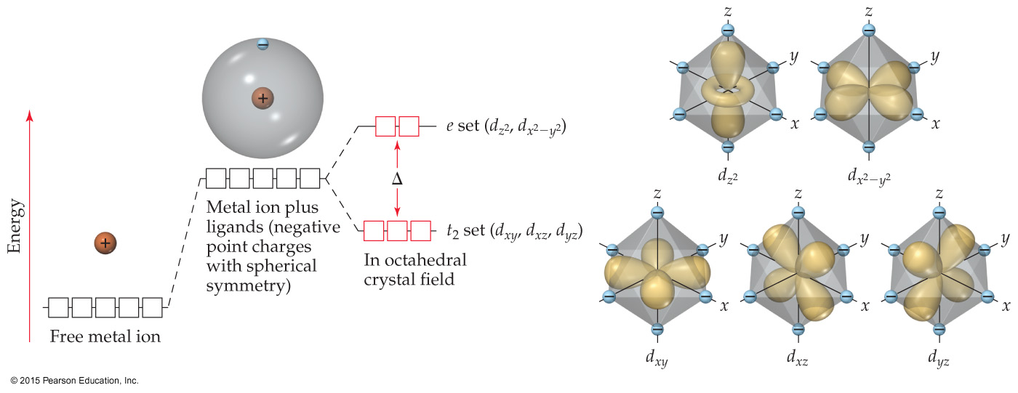
Crystal-Field Theory
Therefore, the d orbitals on a metal in a complex would not be degenerate.
Those that point toward ligands would be higher in energy than those that do not.
Transition
Metals

Slide 36
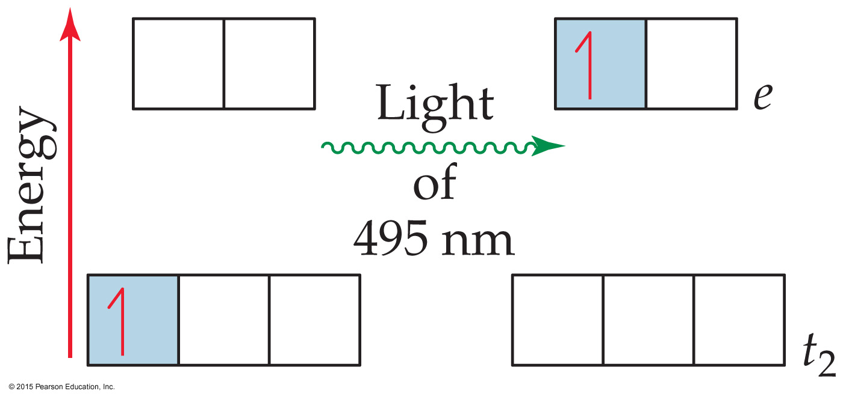
Crystal-Field Theory
The energy difference between the orbitals is called the crystal-field splitting energy 晶体场劈裂能. Δ
This energy gap between d orbitals corresponds to the energy emitted or absorbed as a photon.
Transition
Metals

Slide 37
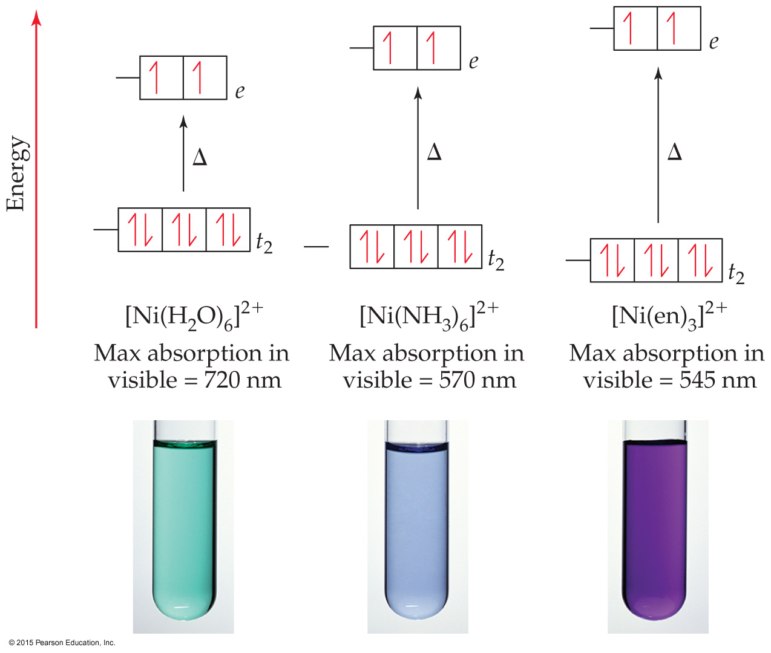
Crystal-Field Theory
The spectrochemical series 光谱化学系列 ranks ligands in order of their ability to increase the energy gap between d orbitals. (This is a variation known as ligand-field theory. 配位场理论)
Transition
Metals

Slide 38
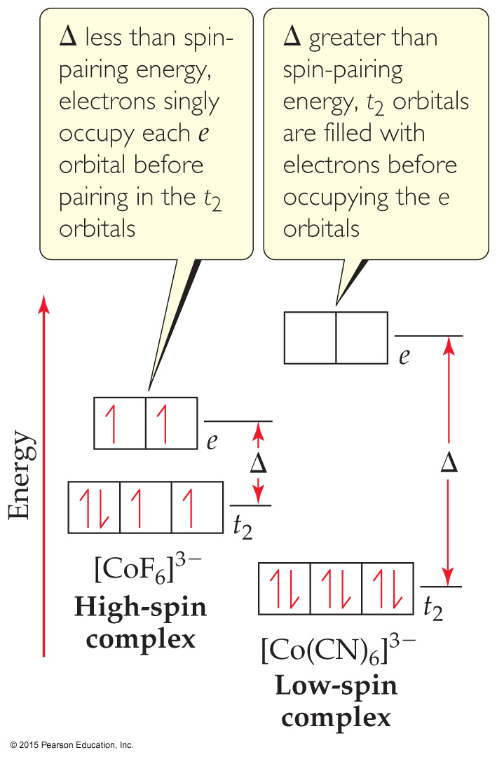
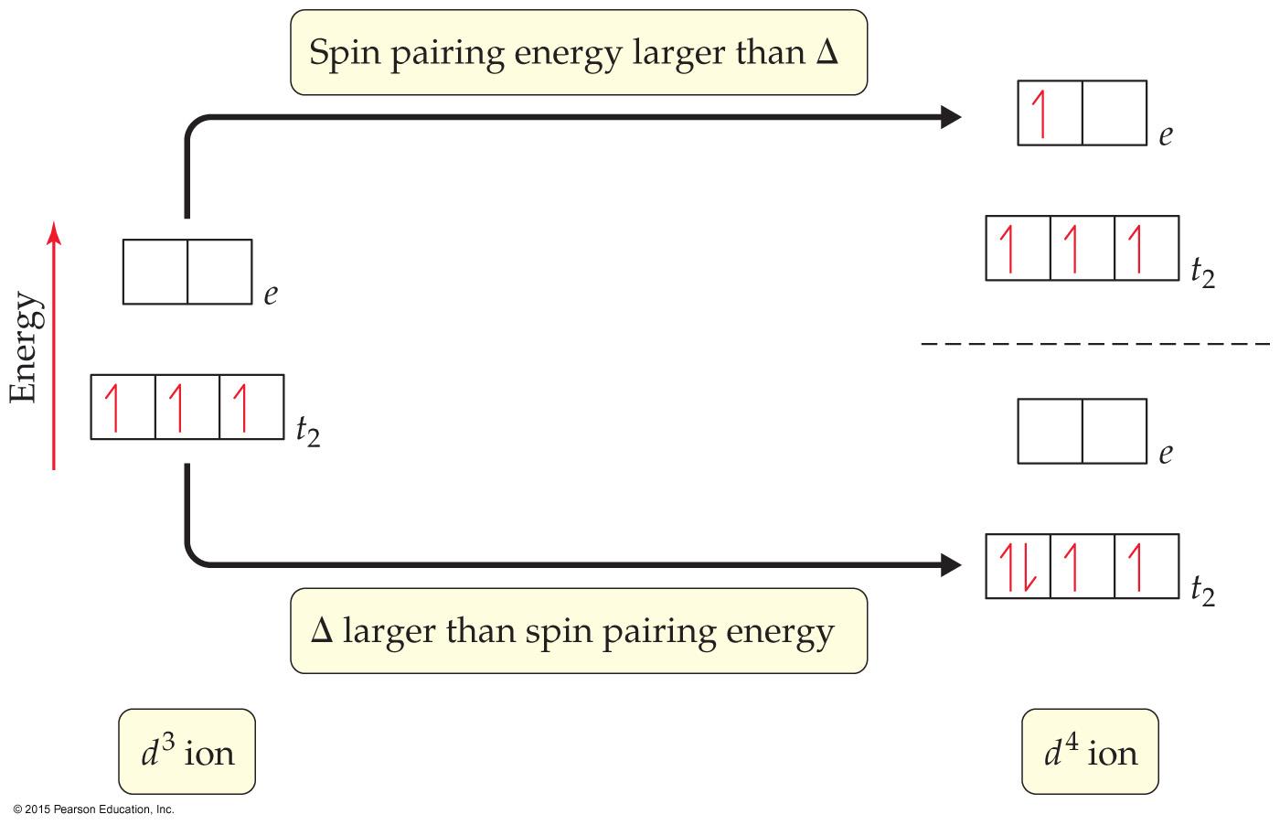
Crystal-Field Theory
Numbers of unpaired electrons can differ depending upon the order in which orbitals are filled. Sample Exercise 23.7
Stronger ligand fields result in greater splitting of orbitals; this is a “high-field” but “low-spin” case.
Weaker ligand fields result in lower splitting of orbitals; this is a “low-field” but “high-spin” case.
Transition
Metals

Slide 39
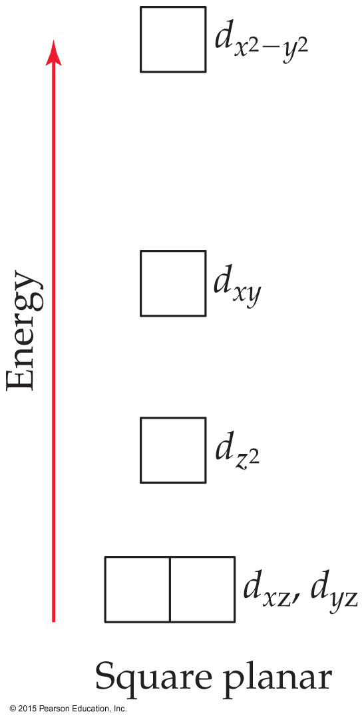
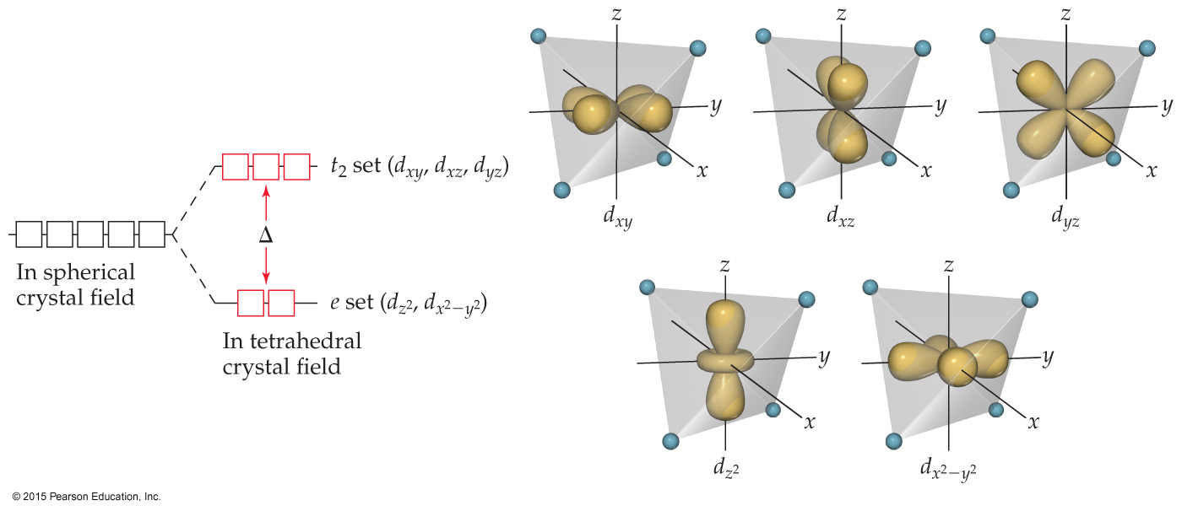
Crystal-Field Theory
Octahedral complexes differ from tetrahedral (left) and square planar (right) complexes because the ligands approach directly on the x-, y-, and z-axes only for octahedral complexes. (Last slide was octahedral.)
Transition
Metals

Slide 40
Transition metals differ from main group metals because transition metals
have very low densities.
are all the same color.
do not react with nonmetals.
d. can have multiple oxidation states.
Notes:
Answer: d

Slide 41
Transition metals differ from main group metals because transition metals
have very low densities.
are all the same color.
do not react with nonmetals.
d. can have multiple oxidation states.
Notes:
Answer: d

Slide 42
The radii of Period 5 and 6 elements in the same group (except for 3B) are virtually the same because of the
difficulty of making accurate measurements.
large number of neutrons in each nucleus.
lanthanide contraction.
d. low oxidation states observed.
Notes:
Answer: c

Slide 43
The radii of Period 5 and 6 elements in the same group (except for 3B) are virtually the same because of the
difficulty of making accurate measurements.
large number of neutrons in each nucleus.
lanthanide contraction.
d. low oxidation states observed.
Notes:
Answer: c

Slide 44
Because transition metal atoms lose their outer s electrons first, almost all of the ions exhibit the ___ oxidation state.
0
+1
+2
+3
Notes:
Answer: c

Slide 45
Because transition metal atoms lose their outer s electrons first, almost all of the ions exhibit the ___ oxidation state.
0
+1
+2
+3
Notes:
Answer: c

Slide 46
_______ is a property of substances in which all of the electrons are paired.
Diamagnetism
Paramagnetism
Ferromagnetism
d. Antiferromagnetism
Notes:
Answer: a

Slide 47
_______ is a property of substances in which all of the electrons are paired.
Diamagnetism
Paramagnetism
Ferromagnetism
d. Antiferromagnetism
Notes:
Answer: a

Slide 48
All ligands have
negative charges.
positive charges.
at least two atoms.
d. at least one lone pair.
Notes:
Answer: d

Slide 49
All ligands have
negative charges.
positive charges.
at least two atoms.
d. at least one lone pair.
Notes:
Answer: d

Slide 50
The number of atoms bonded to a transition metal atom is called the _______ number of the metal atom.
group
oxidation
coordination
d. atomic
Notes:
Answer: c

Slide 51
The number of atoms bonded to a transition metal atom is called the _______ number of the metal atom.
group
oxidation
coordination
d. atomic
Notes:
Answer: c

Slide 52
A transition metal atom and the ligands attached to it constitute the coordination
circle.
square.
sphere.
d. trapezoid.
Notes:
Answer: c

Slide 53
A transition metal atom and the ligands attached to it constitute the coordination
circle.
square.
sphere.
d. trapezoid.
Notes:
Answer: c

Slide 54
In the coordination compound [Pt(NH₃)₂Cl₂], the oxidation number of Pt is ___, and its coordination number is ___.
+4, 4
+2, 4
+4, 2
d. +2, 2
Notes:
Answer: b

Slide 55
In the coordination compound [Pt(NH₃)₂Cl₂], the oxidation number of Pt is ___, and its coordination number is ___.
+4, 4
+2, 4
+4, 2
d. +2, 2
Notes:
Answer: b

Slide 56
Ligands are
Lewis acids.
Lewis bases.
Brønsted acids.
d. Brønsted bases.
Notes:
Answer: b

Slide 57
Ligands are
Lewis acids.
Lewis bases.
Brønsted acids.
d. Brønsted bases.
Notes:
Answer: b

Slide 58
Most transition metal complex ions with a coordination number of 6 have what geometry?
tetrahedral
square planar
trigonal bipyramidal
d. octahedral
Notes:
Answer: d

Slide 59
Most transition metal complex ions with a coordination number of 6 have what geometry?
tetrahedral
square planar
trigonal bipyramidal
d. octahedral
Notes:
Answer: d

Slide 60
Which of the following is a bidentate ligand?
CN¹⁻
SCN¹⁻
NH₃
d. H₂N–CH₂–CH₂–NH₂
Notes:
Answer: d

Slide 61
Which of the following is a bidentate ligand?
CN¹⁻
SCN¹⁻
NH₃
d. H₂N–CH₂–CH₂–NH₂
Notes:
Answer: d

Slide 62
Hemoglobin is a porphyrin that contains _______.
Fe
Mg
Co
d. Cu
Notes:
Answer: a

Slide 63
Hemoglobin is a porphyrin that contains _______.
Fe
Mg
Co
d. Cu
Notes:
Answer: a

Slide 64
Chlorophyll is a porphyrin that contains _______.
Fe
Mg
Co
d. Cu
Notes:
Answer: b

Slide 65
Chlorophyll is a porphyrin that contains _______.
Fe
Mg
Co
d. Cu
Notes:
Answer: b

Slide 66
Which ligand symbol-name pair is not correct?
C₂O₄²⁻; oxalato
H₂O; aquo
OH⁻; hydroxo
NH₃; amino
Notes:
Answer: d

Slide 67
Which ligand symbol-name pair is not correct?
C₂O₄²⁻; oxalato
H₂O; aqua
OH⁻; hydroxo
NH₃; amino
Notes:
Answer: d

Slide 68
[Co(NH₃)₅Cl]Cl₂ is named _______ chloride.
chloropentaamminecobalt(III)
pentaamminechlorocobalt(III)
chloropentaamminecobalt(II)
d. pentaamminechlorocobalt(II)
Notes:
Answer: b

Slide 69
[Co(NH₃)₅Cl]Cl₂ is named _______ chloride.
chloropentaamminecobalt(III)
pentaamminechlorocobalt(III)
chloropentaamminecobalt(II)
d. pentaamminechlorocobalt(II)
Notes:
Answer: b

Slide 70
Na₂[MoOCl₄] is named sodium
tetrachlorooxomolybdate(IV).
oxotetrachloromolybdate(IV).
tetrachlorooxomolybdate(II).
d. oxotetrachloromolybdate(II).
Notes:
Answer: a

Slide 71
Na₂[MoOCl₄] is named sodium
tetrachlorooxomolybdate(IV).
oxotetrachloromolybdate(IV).
tetrachlorooxomolybdate(II).
d. oxotetrachloromolybdate(II).
Notes:
Answer: a

Slide 72
[Ag(SCN)₂]¹⁻ and [Ag(NCS)₂]¹⁻ are
linkage isomers.
coordination-sphere isomers.
stereoisomers.
d. identical ions.
Notes:
Answer: a

Slide 73
[Ag(SCN)₂]¹⁻ and [Ag(NCS)₂]¹⁻ are
linkage isomers.
coordination-sphere isomers.
stereoisomers.
d. identical ions.
Notes:
Answer: a

Slide 74
cis-[Pt(NH₃)₂Cl₂] and trans-[Pt(NH₃)₂Cl₂] are
linkage isomers.
coordination-sphere isomers.
stereoisomers.
d. identical compounds.
Notes:
Answer: c

Slide 75
cis-[Pt(NH₃)₂Cl₂] and trans-[Pt(NH₃)₂Cl₂] are
linkage isomers.
coordination-sphere isomers.
stereoisomers.
d. identical compounds.
Notes:
Answer: c

Slide 76
Objects which are not able to be superimposed on their mirror images are said to be
symmetrical.
chiral.
stereoisomeric.
d. vampire-like.
Notes:
Answer: b

Slide 77
Objects which are not able to be superimposed on their mirror images are said to be
symmetrical.
chiral.
stereoisomeric.
d. vampire-like.
Notes:
Answer: b

Slide 78
Crystal field theory provides a foundation for explaining all of the properties of coordination compounds except
color.
magnetic properties.
geometry.
d. melting point.
Notes:
Answer: d

Slide 79
Crystal field theory provides a foundation for explaining all of the properties of coordination compounds except
color.
magnetic properties.
geometry.
d. melting point.
Notes:
Answer: d

